Slide 1

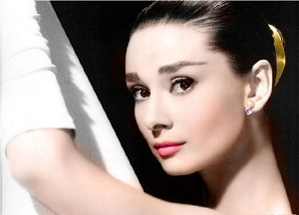
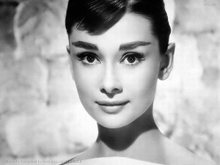
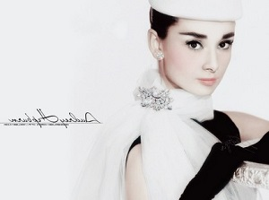
3
Unit 3 Section A
Audrey Hepburn
― A true angel in this world
FOREIGN LANGUAGE TEACHING AND RESEARCH PRESS
AIR FORCE ENGINEERING UNIVERSITY
FOREIGH LANGUAGE TEACHING AND RESEARCH PRESS
AIR FORCE ENGINEERING UNIVERTISY

Slide 2
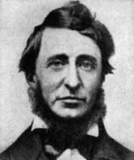
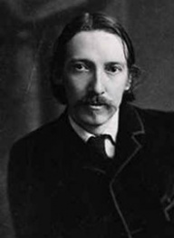
3
3
Life stories
UNIT
Go confidently in the direction of your dreams. Live the life you’ve imagined.
— Henry David Thoreau
Don’t judge each day by the harvest you reap, but by the seeds you plant.
— Robert Louis Stevenson

Slide 3

^{Section A}
3
3
Life stores
UNIT
Audrey Hepburn
— A true angel in this world
To talk about Audrey Hepburn’s life story
Objectives
To fully understand the text
To apply the phrases and patterns
To master the essay writing skill

Slide 4
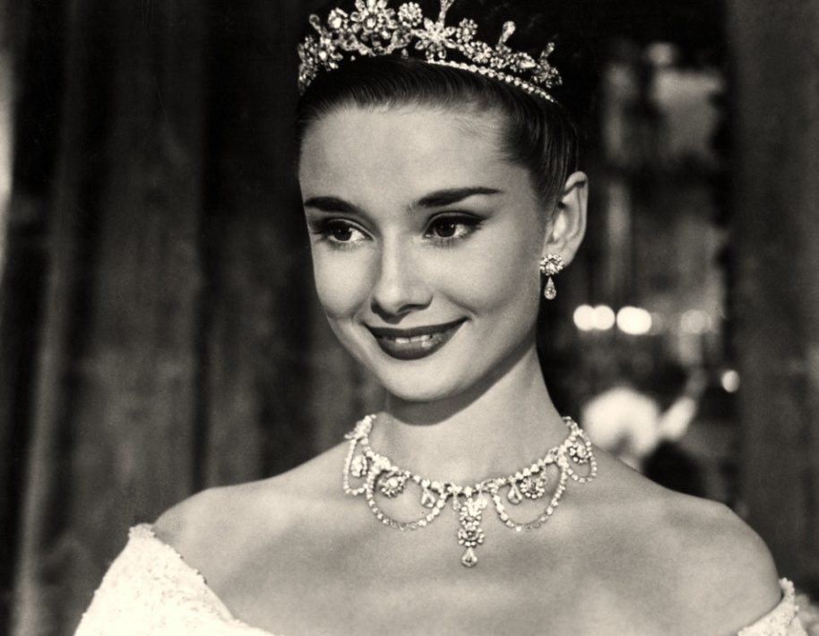




Section A
Audrey Hepburn – A true angel in this world
Contents
Warming-up activities
Text study
Language application
Summary

Slide 5



Section A
Audrey Hepburn – A true angel in this world
Warming-up activities
Lead-in
Pre-reading activities
Cultural background

Slide 6
Lead-in
Matching up
1. Match the names of the people with the movies directed or starred by them.
1 Audrey Hepburn (奥黛丽·赫本) 2 Charlie Chaplin (查理·卓别林) 3 Zhang Ziyi 4 Zhang Yimou 5 Steven Spielberg (史蒂文·斯皮尔伯格)

Slide 7

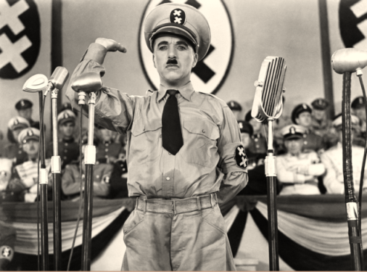
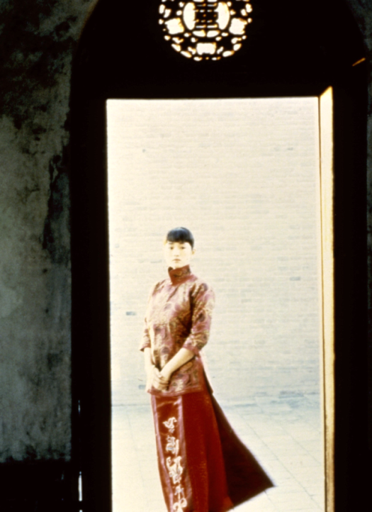
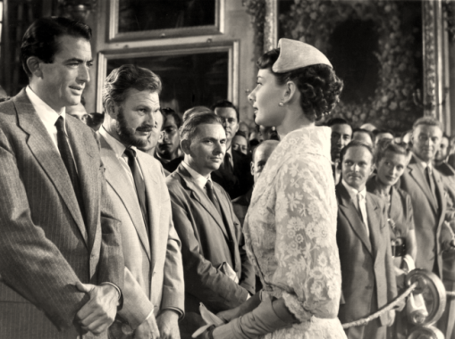
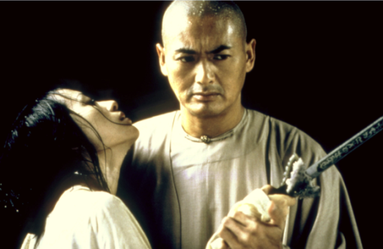
Lead-in
Matching up
1. Match the names of the people with the movies directed or starred by them.
5 Steve Spielberg
2 Charlie Chaplin
A. Jurassic Park
(《侏罗纪公园》)
D. The Great Dictator
(《大独裁者》)
4 Zhang Yimou
1 Audrey Hepburn
3 Zhang Ziyi
B. Raise the Red Lantern (《大红灯笼高高挂》)
E. Crouching Tiger, Hidden Dragon (《卧虎藏龙》)
C. Roman Holiday (《罗马假日》)

Slide 8

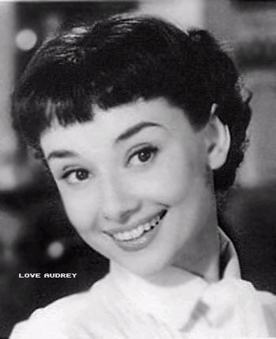
Lead-in
Short answer questions
1. Who was Audrey Hepburn?
Tips
She was a British actress and humanitarian.

Slide 9
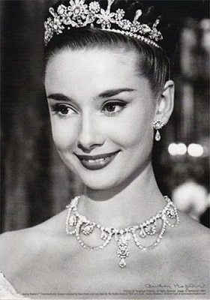
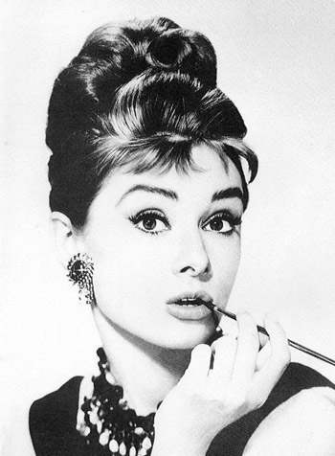
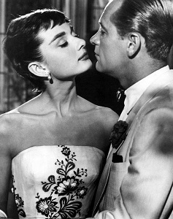
Lead-in
Short answer questions
2. Can you name some of the famous movies starred by Audrey?
Roman Holiday《罗马假日》
Breakfast at Tiffany’s《蒂芬尼的早餐》
Sabrina 《龙凤配》
For More

Slide 10
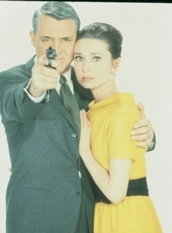
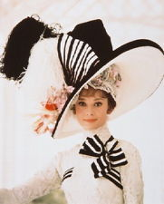
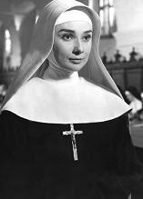
Lead-in
Short answer questions
2. Can you name some of the famous movies starred by Audrey?
Charade《谜中谜》
My Fair Lady《窈窕淑女》
The Nun’s Story 《修女传》

Slide 11
Lead-in
Short answer questions
3. How did Audrey Hepburn influence the world?
Tips
She was universally reckoned to be the most beautiful woman and a style icon in the world. She still influences major stars of today and remains the fashion icon of the present world.
She took advantage of her fame and dedicated the remainder of her life to doing humanitarian work for UNICEF. She drew attention to the issue of the world’s poorest children and awakened the world into action.

Slide 12

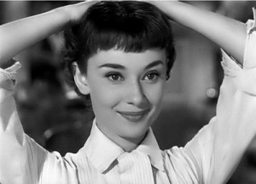
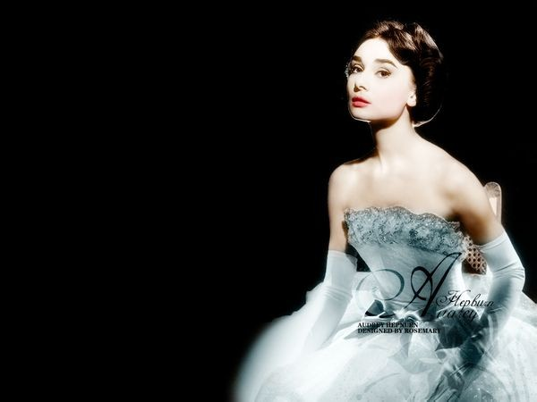
Pre-reading activities
Watch and talk
Watch the video about Audrey Hepburn, take down the key points and then make a presentation about her life story.

Slide 13

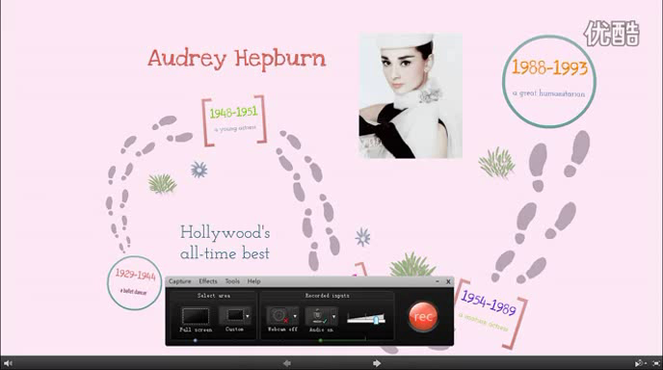
Pre-reading activities
Watch and talk
Back

Slide 14
Pre-reading activities
Watch and talk
Now give your presentation about Audrey’s life story according to the following outline.
1929-1944 a ballet dancer
1948-1951 a young actress
1952-1953 a successful actress
1954-1989 a mature actress
1988-1993 a great humanitarian

Slide 15


Pre-reading activities
Compound dictation
Listen to a short passage concerning the life story of Audrey Hepburn.
Audrey Hepburn was born in Brussels, Belgium, on May 4, 1929. Although she was the daughter of a Dutch baroness (女男爵) and a wealthy English banker, Audrey had a difficult childhood. Her parents ________ when she was young and Audrey went to live with her mother in the Netherlands. Soon after, the German army ________ Holland. During the Nazi occupation, her family faced starvation and Audrey ____________ severe anemia (贫血), and respiratory problems.
divorced
invaded
suffered from
To be continued

Slide 16
Pre-reading activities
Compound dictation
Listen to a short passage concerning the life story of Audrey Hepburn.
Audrey was sixteen when the occupation ended. She and her mother returned to London. Her big break came when the French novelist Colette __________ her in a crowd and insisted that Hepburn be cast as Gigi in a Broadway adaptation of her novel. In spite of Hepburn’s ____________, audiences and critics alike were captivated (迷住) by her performance.
discovered
inexperience
To be continued

Slide 17
Pre-reading activities
Compound dictation
Listen to a short passage concerning the life story of Audrey Hepburn.
Subsequently, William Wyler chose her to be the lead in Roman Holiday, _________ Gregory Peck. For her role as Princess Ann, she won the 1953 Academy Award for Best Actress and began a string of box office hits.
Audrey Hepburn became a goodwill ambassador and spokesperson for UNICEF in 1986. Traveling to areas ___________ famine and devastation, Hepburn worked to raise public __________ of the plight (困境) faced by children in times of crises.
opposite
afflicted by
awareness
To be continued

Slide 18
Pre-reading activities
Compound dictation
Listen to a short passage concerning the life story of Audrey Hepburn.
Her commitment to improve the welfare of children across the world was intense and genuine. This commitment earned her the Presidential Medal of Freedom and the ____________ Award from the Congress on Racial Equality. Soon after her trip to Somalia in 1991, Hepburn __________________ colon cancer. In 1993, Audrey Hepburn died at the age of 63.
Humanitarian
was diagnosed with

Slide 19

Cultural background
UNICEF
Questions Previewing
1. How did UNICEF come into being?
Tips
2. What is UNICEF’s major task?
Tips
3. What is the role of UNICEF Ambassador of Goodwill?
Tips

Slide 20


Cultural background
UNICEF
1. How did UNICEF come into being?
UNICEF (United Nations International
Children’s Emergency Fund) was created by the United Nations General Assembly on December 11, 1946, to provide emergency food and healthcare to children in countries that had been devastated by World War II.

Slide 21

Cultural background
UNICEF
2. What is UNICEF’s major task?
UNICEF provides long-term humanitarian
and developmental assistance to children and mothers in developing countries. UNICEF’s programs emphasize developing community level services to promote the health and well-being of children.

Slide 22
Cultural background
UNICEF
3.What is the role of UNICEF Ambassador of Goodwill?
The role of Goodwill Ambassador
allows celebrities with a demonstrated interest in UNICEF issues to use their fame to draw attention to important issues and create public awareness.

Slide 23


Section A
Audrey Hepburn – A true angel in this world
Text study
Main idea & structure
Language focus
Critical thinking

Slide 24

Main idea & structure
Main ideas of the parts
Audrey Hepburn, as an actress, thrilled audiences with her ______________________________. (Para. 1)
starring roles in noteworthy films
Despite her success in the film domain, what role did she most prefer portraying? (Para. 2)
Tips
The roles of an exemplary mother and a UNICEF Goodwill Ambassador.

Slide 25

Main idea & structure
Main ideas of the parts
Part I — (Paras. 1- __)
2
Audrey Hepburn was successful in the film domain, but she most preferred playing the roles of a mother and a UNICEF Goodwill Ambassador.

Slide 26
Main idea & structure
Main ideas of the parts
What did Audrey Hepburn suffer as a young girl in the war? (Para. 3)
Tips
hungry and malnourished;
her family was bankrupted;
her father abandoned the family;
two of her uncles were taken captive and killed;
she was grabbed off the street by Nazis;
she escaped and huddled in a cold, foul
basement full of rats.

Slide 27
Main idea & structure
Main ideas of the parts
Confronted with the desperate reality of her life, what did Audrey Hepburn do? (Para. 4)
Tips
transcended
She refused to give up and ____________ those challenges.

Slide 28
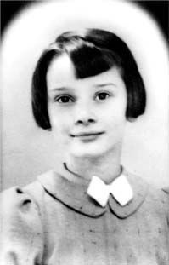
Main idea & structure
Main ideas of the parts
Paras. 3-4
As a young girl suffering from the war, Audrey confronted the desperate reality of her life, but she transcended those challenges.

Slide 29
Main idea & structure
Main ideas of the parts
How did Audrey Hepburn start her movie career? (Para. 5)
Tips
She was spotted by a producer and eventually landed a role in the film Roman Holiday.
Audrey Hepburn was ___________ to an internationally famous movie star. Though she got sufferings in life, she never let her sadness _________
her or __________ her hope for a brighter future. (Para. 6)
transformed
overcome
jeopardize

Slide 30
Main idea & structure
Main ideas of the parts
Paras. 5-6
After the war, Audrey immigrated to London and grew to be an internationally famous movie star.

Slide 31

Main idea & structure
Main ideas of the parts
Paras. 7-8
After becoming famous and wealthy, Audrey remained a _________, ________ and ______________ woman.
generous
simple
compassionate

Slide 32
Main idea & structure
Main ideas of the parts
What happened to Audrey Hepburn in 1988? (Para. 9)
Tips
She accepted the role as a Goodwill Ambassador for UNICEF and in that role, she found her lifelong passion.
What did she do as a Goodwill Ambassador for UNICEF? (Para.10)
Tips
She traveled to the most difficult places around the world to offer help and raise world awareness of wars and droughts.

Slide 33
Main idea & structure
Main ideas of the parts
What did Audrey Hepburn believe in? (Para.11)
Tips
She believed deeply in the ideology that all people share in the duty to care for those in need.

Slide 34
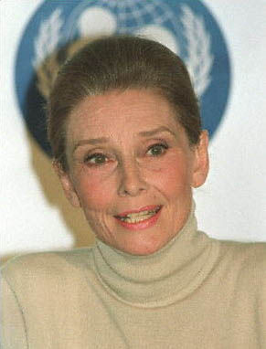
Main idea & structure
Main ideas of the parts
Paras. 9-11
In 1988, Audrey accepted the role as a Goodwill Ambassador for UNICEF and traveled around the world to help those in need during the last five years of her life.

Slide 35
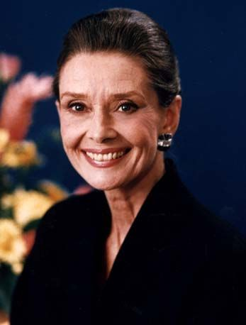
Main idea & structure
Main ideas of the parts
Paras. 12-14
Audrey got _______ and died at 63 years of age, but she remained a great woman till the end of her life. Her passion for service is ________.
cancer
enduring

Slide 36
Main idea & structure
Main ideas of the parts
Part II — (Paras. 3- ___)
14
This part tells of the life story of Audrey Hepburn. She ___________ the challenges in her earlier life and became an internationally famous actress. But she remained a __________, simple and ______________ woman and devoted her later years to ____________ work as a Goodwill Ambassador for UNICEF. Though she died of cancer, her _______ for service was enduring.
transcended
generous
compassionate
humanitarian
passion

Slide 37
Main idea & structure
Main ideas of the parts
What can we see from Audrey Hepburn’ words? (Para. 15)
“记住，如果你在任何时候需要一只手来帮助你，你可以在自己手臂的末端找到它。随着你的成长，记住你还有一只手，一只用来帮助自己，另一只用来帮助别人。”
“Remember, if you ever need a helping hand, it’s at the end of your arm. As you get older, remember you have another hand: The first is to help yourself, the second is to help others.”
The majesty of her spirit of social responsibility and dedication.
“要想有美丽双眸，就要善于发现他人优点；要想双唇动人，只说和善之辞；要想镇定自信，谨记自己始终与大家同行。”
“For beautiful eyes, look for the good in others; for
beautiful lips, speak only words of kindness; and for poise, walk with the knowledge that you are never alone.”

Slide 38
Main idea & structure
Main ideas of the parts
Part III — (Para. 15)
From Audrey’s words, we can see the majesty of her spirit of social responsibility and dedication.

Slide 39
Main idea & structure
Main ideas of the text
This text is a brief biography of Audrey Hepburn, one of the world’s most famous actresses of all time. It presents the facts about Audrey Hepburn’s life including her young life, her route to success, her life after becoming famous, and especially her contribution to the world as a Goodwill Ambassador for UNICEF. It describes Audrey Hepburn’s personality and provides facts and quotes as an explanation for why she remains a great actress and humanitarian.

Slide 40
Main idea & structure
Structure of the text
Introduction
Audrey Hepburn was successful in the film domain, but she most preferred playing the roles of a mother and a UNICEF Goodwill Ambassador. (Paras. 1-2)

Slide 41
Main idea & structure
Structure of the text
Introduction
Main body: Audrey Hepburn’s life story
(in chronological order)

Slide 42
Main idea & structure
Structure of the text
Audrey Hepburn’s life story
Her young life
(Paras. 3-4)
Her route to success
(Paras. 5-6)
Her character after becoming famous
(Paras. 7-8)
Her death and enduring passion
(Paras. 12-14)
Her contribution to the world as a Goodwill Ambassador (Paras. 9-11)

Slide 43
Main idea & structure
Structure of the text
Introduction
Main body: Audrey Hepburn’s life story
Conclusion
From Audrey’s words, we can see the majesty of her spirit of social responsibility and dedication. (Para. 15)

Slide 44
Main idea & structure
Structure of the text
Introduction
Main body: Audrey Hepburn’s life story
Conclusion

Slide 45
Main idea & structure
Summary of the text
Audrey Hepburn, as an actress, ______ audiences with her wonderful acting in many popular films. Despite her success in the film domain, she preferred playing the roles of an ________ mother and a UNICEF Goodwill Ambassador.
Audrey Hepburn suffered as a young girl in the war. _______ by the desperate reality of her life, she refused to give up and __________ those challenges.
thrilled
exemplary
Afflicted
transcended
To be continued

Slide 46
Main idea & structure
Summary of the text
After the war, she __________ to London, and finally got a chance to become an internationally famous movie star. Despite her fame and wealth, Audrey remained a ________, simple and _____________ woman. In 1988, Audrey accepted the role as a Goodwill Ambassador for UNICEF and in that role, she found her lifelong _______. She traveled to the most difficult places around the world to offer help and raise world __________ of wars and droughts.
immigrated
generous
compassionate
passion
awareness
To be continued

Slide 47
Main idea & structure
Summary of the text
In 1992, Audrey was _______ by cancer and returned home with her family. But she remained a great woman till the end of her life. Her passion for service is _________.
The _______ of Audrey Hepburn’s spirit of social responsibility and ________ lives on in her words.
stricken
enduring
majesty
dedication

Slide 48
Language focus
Practical phrases
Practical Phrases | Specific Meanings
1. be afflicted by | 受…痛苦；受…折磨
2. transform sb./sth. from… to… | 把某人/物从…转变成…
3. embark on/upon | 开始，着手
4. deprive sb. of sth. | 剥夺某人某物
5. be drowned in | 埋头于；沉溺于
6. share in | 分享；分担；参与
7. lead by example | 以身作则
8. be stricken by | 遭受…不幸

Slide 49

Language focus
Practical phrases
受…痛苦；
受…折磨
短语逆译
be afflicted by
短语应用
由于遭受无休止战争的折磨，人们生活在极度贫困之中。
意群提示
(be afflicted by / endless war / extreme poverty)
Afflicted by the endless war, people live in extreme poverty.

Slide 50
Language focus
Practical phrases
把某人/物从…转变成…
transform sb./sth. from… to…
短语逆译
短语应用
军训使他们从普通地方青年转变成合格的军校学员。
意群提示
(military training/ civilian youth/ transform / cadet)
The military training transformed them from ordinary civilian youths to qualified cadets.

Slide 51
Language focus
Practical phrases
开始，着手
短语逆译
embark on/upon
短语应用
带着巨大的决心与勇气，他开始了独自横渡太平洋的航行。
意群提示
(tremendous/ determination / embark on/ solo /voyage)
With tremendous determination and courage, he embarked on a solo voyage across the Pacific Ocean.

Slide 52
Language focus
Practical phrases
剥夺某人某物
短语逆译
deprive sb. of sth.
短语应用
由于贫困，许多偏远地区的儿童被剥夺了受教育的权利。
意群提示
(remote areas / deprive… of… /right to education)
Because of poverty, many children in remote areas are deprived of their right to education.

Slide 53
Language focus
Practical phrases
埋头于；沉溺于
短语逆译
be drowned in
短语应用
这个孩子沉浸在侦探小说引人入胜的情节里，废寝忘食。
意群提示
(be drowned in / detective story / appealing plots / neglect one’s meals and sleep)
Drowned in the appealing plots of the detective story, the child neglected his meals and sleep.

Slide 54
Language focus
Practical phrases
分享；分担；参与
短语逆译
share in
短语应用
所有人，不管是男性还是女性，年老还是年轻，富有还是贫穷，都应参与到构建和谐社会的共同任务中。
意群提示
(share in / common task / harmonious society)
All people, whether they are male or female, old or young, rich or poor, should share in the common task of creating a harmonious society.

Slide 55
Language focus
Practical phrases
以身作则
短语逆译
lead by example
短语应用
好老师会以身作则而不只是口头上告诉学生该做什么。
意群提示
(lead by example/ rather than)
Good teachers lead by example rather than only tell the students what to do.

Slide 56
Language focus
Practical phrases
遭受…不幸
短语逆译
be stricken by
短语应用
2015年4月25日，尼泊尔遭受了8.1级大地震的袭击。
意群提示
(be stricken by / massive earthquake / magnitude)
Nepal was stricken by a massive earthquake with a magnitude of 8.1 on April 25, 2015.

Slide 57
Language focus
Functional patterns
Functional Patterns | Functions & Usages
1. Despite ..., sth. that sb. most prefers doing is (not)… | 用于表达“与表面现象或人们预期相反的情况”。
2. As…, sb. is aware of/knows… | 用于表达“某人在特定身份下，对事物的洞察”。
3. Sb. who would become … began as a … | 用于表达“某人发展道路的开端”。

Slide 58
Language focus
Functional patterns
原句译文
尽管在电影界获得成功，但她最愿意塑造的角色却并不在影片中。
逆译练习
Despite her success in the film domain, the roles she most preferred portraying were not in movies. (Para 2, L1)
句型提炼

Slide 59

Language focus
Functional patterns
句型提炼
Despite ..., sth. that sb. most prefers doing is (not)…
应用提示
用于表达“与表面现象或人们预期相反的情况”。
句型应用

Slide 60
Language focus
Functional patterns
典型例句
尽管他在商界很成功，但他最想追求的目标是成为美声歌唱家。
意群提示
(business field / pursue / bel canto singer)
Despite his success in business field, the goal he most prefers pursuing is to become a bel canto singer.

Slide 61
Language focus
Functional patterns
原句译文
作为一名在纳粹占领下的祖国荷兰生活的小女孩，奥黛丽·赫本清楚战争所带来的野蛮、死亡和破坏。
逆译练习
As a young girl during the Nazi occupation of her native Holland, Audrey Hepburn was aware of the brutality, death, and destruction of war. (Para. 3, L1)
句型提炼

Slide 62
Language focus
Functional patterns
句型提炼
As…, sb. is aware of/knows…
应用提示
用于表达“某人在特定身份下，对事物的洞察”。
句型应用

Slide 63
Language focus
Functional patterns
典型例句
作为临床经验丰富的医生，他很清楚病人的最佳治疗方案。
意群提示
(clinical experience/ treatment )
As a doctor with rich clinical experience, he is aware of the best treatment for the patient.

Slide 64
Language focus
Functional patterns
原句译文
这个日后将成为世界上最具魅力女星的小女孩刚开始只是一个无名难民，直面生命中的恐惧和脆弱。
逆译练习
The little girl who would become the world’s most magical actress began as an
anonymous refugee confronting life’s horrors and fragility firsthand. (Para. 4, L1)
句型提炼

Slide 65
Language focus
Functional patterns
句型提炼
Sb. who would become … began as a …
应用提示
用于表达“某人发展道路的开端”。
句型应用

Slide 66
Language focus
Functional patterns
典型例句
这个日后将成为世界知名亿万富翁的年轻人刚开始只是一个没有固定收入的小商贩。
意群提示
(billionaire / stable income/ peddler)
The young man who would become the world famous billionaire began as a peddler without stable income.

Slide 67


Language focus
Language appreciation
她经历了两次离婚，并忍受着战争记忆带给她的悲伤，然而，奥黛丽从不让这些悲伤支配自己，或者影响自己对美好未来的向往。
a. She suffered through two divorces and from her memories of the war. Yet, Audrey never let her sadness overcome her or jeopardize her hope for a brighter future. (Para.6, L10)

Slide 68
Language focus
Language appreciation
b. From Bangladesh, … to Somalia, Audrey Hepburn traveled representing UNICEF, making over 50 emotionally draining and physically dangerous missions into bleak destinations to raise world awareness of wars and droughts. (Para.10, L5)
从孟加拉国……到索马里，奥黛丽·赫本代表联合国儿童基金会四处奔走，承担了五十多项劳心劳力、危及生命安全的任务，深入到荒凉之地，唤起世界人民对战争和旱灾的关注。

Slide 69
Language focus
Language appreciation
奥黛丽觉得，太多的儿童被剥夺了简单的快乐而陷入无边的痛苦之中，这是一种罪恶。
c. Audrey felt it was wicked that billions of children were deprived of simple joys and drowned in overwhelming misery. (Para.11, L1)

Slide 70
Language focus
Language appreciation
即使在她63岁生命终止的时候，她仍然充满着关爱，永远象征着纯朴、仁爱、魅力和善良。
d. Even as her life ended at 63 years of age, she remained a gracious woman who perpetually signified simplicity, charity, charm and kindness.(Para.14, L1)

Slide 71
Language focus
Language appreciation
“要想有美丽双眸，就要善于发现他人优点；要想双唇动人，只说和善之辞；要想镇定自信，谨记自己始终与大家同行。”
e. “For beautiful eyes, look for the good in others; for beautiful lips, speak only words of kindness; and for poise, walk with the knowledge that you are never alone.” (Para.15, L4)

Slide 72

Critical thinking
Theme exploration
1 What do you think is the most important
thing for a person to succeed in the film
domain?
Tips
2 What do you think of successful people’s
passion for serving those in need?
Tips
3 In your mind, who, as a celebrity, can equal Audrey Hepburn’s goodwill and dedication?
Tips

Slide 73

Critical thinking
Theme exploration
1 What do you think is the most important thing for a person to succeed in the film domain?
• Experience
• Determination
• Opportunity
• Beauty
• Wealth

Slide 74
Critical thinking
Theme exploration
2 What do you think of successful people’s passion for serving those in need?
• They want to help people with their influence.
• It’s just a way for them to seek fame.

Slide 75
Critical thinking
Theme exploration
3 In your mind, who, as a celebrity, can equal Audrey Hepburn’s goodwill and dedication?
I think Bill Gates can equal Audrey Hepburn’s goodwill and dedication. In 2000 he launched the Bill & Melinda Gates Foundation which is said to be one of the largest private foundations in the world. The primary aims of the foundation are, globally, to enhance healthcare and reduce extreme poverty, and in America, to expand educational opportunities and access to information technology.

Slide 76
Critical thinking
Culture exploration
Many celebrities in western and eastern countries alike get involved with charity work. Some say they are just promoting their overall images. What do you think?
I think it is a good idea if they show a true commitment and genuine interest.
Celebrities usually enjoy considerable wealth. They can donate money to charity cause. And they can also help to get more using their fame to raise awareness of certain cause for those in need. People wouldn’t listen to boring politicians，but they would show interest in what celebrities say.

Slide 77



Critical thinking
Watch a video clip and discuss the following questions.
Q1: What is the most important message that the video conveys?
Tips
Q2: If you become famous, what would you do for this world?
Tips
Video Watching

Slide 78


Critical thinking
Back

Slide 79

Critical thinking
1. What is the most important message that the video conveys?
The video is urging people to join the Audrey Hepburn Society to ensure the survival and development of every child in this world and to continue the work that was so dear to Audrey Hepburn’s heart.

Slide 80
Critical thinking
2. If you become famous, what would you do for this world?
Travel to poor places to show the local people they are cared and loved;
Donate money or things to help those in need;
Adopt homeless children;
Set up funds to carry out research on difficult issues, such as incurable diseases;
Build schools in remote areas to ensure children are educated;
Take advantage of my fame to raise public awareness of the present problems.

Slide 81

Section A
Audrey Hepburn – A true angel in this world
Language application
Writing devices
Oral reproduction
Paragraph translation

Slide 82
Writing devices
Essay writing
Further develop a narrative essay
A biography is a narrative essay about another person’s life. It narrates, analyzes and interprets the most important facts of someone’s life. Generally, most biographies are written in chronological order. There may be some time periods grouped around a major theme. Still others focus on specific topics or accomplishments.
The following steps can help you develop a narrative essay in chronological order:
to be continued

Slide 83
Writing devices
Essay writing
Step 1: Choose a person about whom you would like to write biographies.
Step 2: Search for information or important details about the person you have chosen to write about.
Step 3: Make an outline, make up a list of all the details and then number these details according to the order in which they occurred. Select only those that can best portray the person you are describing and ignore those unimportant ones.
Step 4: Write a rough draft based on the listed details. Use time signals like when, during, soon, etc. to help connect details as you move from the beginning to the end of your narrative.

Slide 84

Writing devices
Essay writing
Let’s look at the following sentences taken from Text A, and pay attention to the underlined parts to see how time signals are used to tell the life story of Audrey.

Slide 85
Writing devices
Essay writing
As a young girl during the Nazi occupation of her native Holland, Audrey Hepburn was aware of the brutality, death, and destruction of war. (Para. 3)
After the war, Audrey and her mother left Holland, arriving in London as poor immigrants. (Para. 5)
Soon, Audrey was transformed from a malnourished immigrant to an internationally famous movie star. (Para. 6)
to be continued

Slide 86
Writing devices
Essay writing
In presenting details, be sure to include not only what happened but also how you or others felt about what was going on. For example, in describing Audrey’s success in the film domain in Paragraph 6, director Billy Wilder’s comments are used to indicate how she was admired by people.
Step 5: Revise and proofread the draft until you think the narrative is coherent and well developed.

Slide 87
Writing devices
Essay writing
Read the sample essay and see how it develops in chronological order.

Slide 88
Writing devices
Essay writing
Topic:
O. Henry: A great writer of short stories
Details might be organized in chronological
order:
• when he was born
• how he started writing short stories
• what he had achieved
• when he died
to be continued

Slide 89
Writing devices
Essay writing
Sample Essay:
O. Henry is an American writer of short stories, best-known for his ironic plot twists and surprise endings.
He was born on September 11, 1862 in North Carolina, where he spent his childhood.
He went to Texas in 1882 and worked at various jobs and later as a teller, at an Austin bank (1891-1894) and as a newspaperman for the Houston Post.
to be continued

Slide 90
Writing devices
Essay writing
Sample Essay:
In 1896 an unexplained shortage of money at the Austin bank was blamed on him. Although
many people believed him innocent, he fled to Honduras, but returned to be with his wife, who was fatally ill. He eventually served three years in prison, where he first started writing short stories. He eventually served three years in prison, where he first started writing short stories.
to be continued

Slide 91
Writing devices
Essay writing
Sample Essay:
Upon his release he settled in New York City and became a highly successful and prolific contributor to various magazines. Although his stories have been criticized as shallow and contrived, O. Henry did catch the color and movement of the city and evidenced a genuine sympathy for ordinary people. His approximately 300 stories are collected in Cabbages and Kings (1904), The Four Million (1906), The Voice of the City (1908), Options (1909), and others.
to be continued

Slide 92
Writing devices
Essay writing
Sample Essay:
He died on June 5, 1910 in New York City, at the age of 47, an alcoholic and virtually penniless.

Slide 93
Writing devices
Essay writing
Writing practice
Directions: Write an essay of no less than 200 words on one of the following topics. One topic has an outline that you can follow.

Slide 94
Writing devices
Essay writing
Topic: A most influential movie director or movie maker
Details might be organized in chronological order:
• when he / she was born
• how and where he / she grew up
• what educational background he / she had
• how he / she started his / her career
• what he / she had achieved

Slide 95
Writing devices
Essay writing
More topics:
• A man / woman who changed the world
• A great sportsman / sportswoman

Slide 96
Oral reproduction
Story telling
Tell the life story of a celebrity or the person you are familiar with.

Slide 97

Oral reproduction
Story telling
You can follow the outline given below.
Part I. General introduction
1. Who he is;
2. Why you want to tell his/her story;
3. Your general impression about him/her.
To be continued

Slide 98
Oral reproduction
Story telling
You can follow the outline given below.
Part II. His / Her life story
When he / she was born
How and where he / she grew up
What educational background he / she had
How he / she started his / her career
What he / she had achieved
Part III. Conclusion
How people evaluate him / her
To be continued

Slide 99
Oral reproduction
Story telling
You may adopt the following expressions.
thrill … with…
confront life’s horrors and fragility
be afflicted by the desperate reality
transcend the challenges
transform from… to…
feel a deep sense of responsibility
lifelong passion for …
embark on
raise world awareness of…
lead by example
be stricken by

Slide 100
Paragraph translation
Translate a paragraph based on the summary of the text by using the expressions from the text.

Slide 101
Paragraph translation
奥黛丽·赫本是国际知名影星。在幼年时期，她经受了战争残酷现实的折磨。但她并没有因此而放弃希望，而是克服种种挑战，最终成长为一名受世人喜爱的演员。尽管名利双收，奥黛丽始终保持慷慨、纯朴、富有同情心、向需要帮助的人伸出援助之手。 1988年，她被任命
be afflicted by
transcend all the challenges
beloved
compassionate
those in need
To be continued

Slide 102
Paragraph translation
为联合国儿童基金会亲善大使，将所有激情投入到人道主义工作中。她的足迹遍布非洲、亚洲和拉丁美洲，为地球上最困难的村落带去希望，也唤起世界人民对战争和旱灾的关注。1993年，奥黛丽因患癌症离世，但她将永远活在人们的心中——一位真正的人间天使。
a Goodwill Ambassador for UNICEF
humanitarian
raise world awareness of…
a true angel in the world
Sample

Slide 103
Paragraph translation
Audrey Hepburn was an internationally famous movie star. In her childhood, she was afflicted by the desperate reality of war. But she never gave up hope and instead transcended all the challenges to grow into a most beloved actress in the world. Despite her fame and wealth, Audrey always remained generous, simple and compassionate, lending a helping hand to those in need. In 1988, she was appointed a Goodwill Ambassador for UNICEF and devoted all her passion to humanitarian work. She travelled to Africa, Asia and Latin America to take hope to the most difficult villages on earth and raise world awareness of wars and droughts. In 1993, Audrey died of cancer, but she will always live in people’s heart, a true angel in the world.

Slide 104


Section A
Audrey Hepburn – A true angel in this world
Summary
Revision of
the useful expressions
Thematic study
Revision of
the functional patterns

Slide 105
Revision of
the useful expressions
Language points—Useful expressions
1 使…感到兴奋或激动
2 被俘
3 飞快地跑开
4 直面生命中的恐惧
5 克服挑战
6 获得一个角色
7 把某人从…变成…
8 危及某人对…的向往
9 强烈的责任感
10 减轻痛苦
thrill sb. with sth.
be taken captive
dart off
confront life’s horrors
transcend challenges
land a role
transform sb. from… to…
jeopardize one’s hope for …
a deep sense of responsibility
alleviate suffering

Slide 106
Revision of
the useful expressions
Language points—Useful expressions
one’s lifelong passion for…
11 对…毕生的热情
12 开始，着手
13 劳心劳力、危及生命 安全的任务
14 唤起世界人民对战争 和旱灾的关注
15 剥夺某人某物
16 陷入无边的痛苦之中
17 分担责任
18 以身作则
19 患了癌症
embark on/upon
emotionally draining and physically dangerous missions
raise world awareness of wars and droughts
deprive sb. of sth.
be drowned in overwhelming misery
share in the duty
lead by example
be stricken by cancer

Slide 107
Revision of
the functional patterns
Language points—Useful patterns
Functions & Usages | Sentence Patterns
1. 用于表达“与表面现象或人们预期相反的情况”。
2. 用于表达“某人在特定身 份下，对事物的洞察”。
3. 用于表达“某人发展道路 的开端”。
Despite ..., sth. that sb. most prefers doing is(not)…
As…, sb. is aware of/knows…
Sb. who would become … began as a …
Notes:
上面挤，下面空

Slide 108
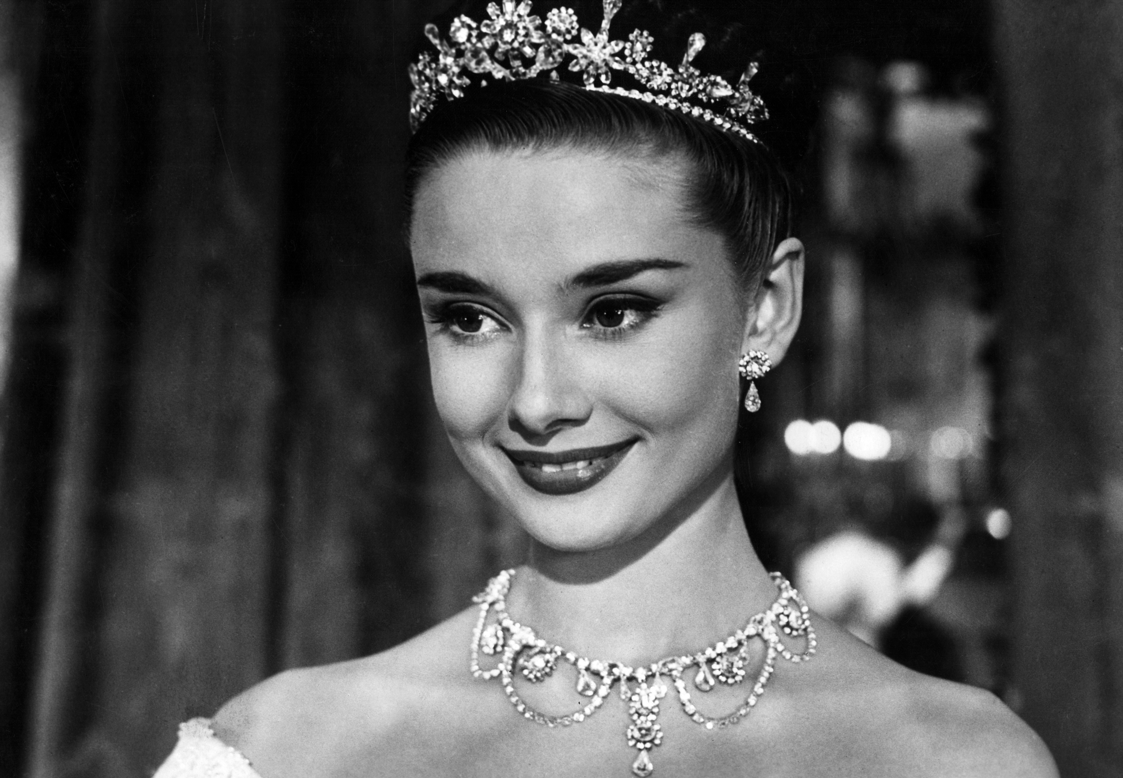
Section A
Audrey Hepburn – A true angel in this world
The end

